Slide 1
The NIH Intramural Research Program
Sample Slides for Use in
Overview Presentations

Slide 2
What is the Intramural Research Program?
The IRP is the internal research program of the NIH, known for its highly successful, innovative, and synergistic approach to biomedical science
With 1,200 Principal Investigators and more than 2,300 postdoctoral fellows conducting basic, translational, and clinical research, the IRP is the largest biomedical research institution in the world
The IRP’s distinctive research environment is able to leverage its extensive resources and expertise to perform truly interdisciplinary research, from the bench to the bedside

Slide 3
IRP Shared Research Resources
Center for Human Immunology
Division of Veterinary Resources
Image Probe Development Center
Mouse Imaging Facility
Natural Products Repository
RNAi Screening Facility
Advanced Imaging and Microscopy Resource
MRI Research Facility
Zebrafish Core
NIH Intramural Sequencing Center
High-Throughput Drug Candidate Screening
… to name a few

Slide 4
Supercomputing
The first supercomputer completely dedicated to advancing biomedical research listed among the 100 most powerful computers in the world

Slide 5
The NIH Clinical Center
The world’s largest hospital entirely devoted to clinical research

Slide 6
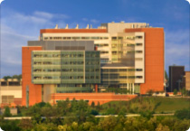
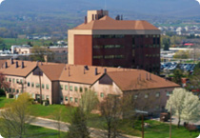
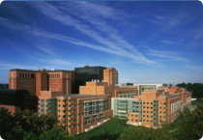
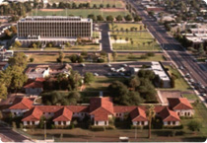
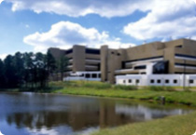
Our Research Campuses
Bayview Campus
Baltimore
Rocky Mountain Laboratory
Frederick National Laboratory for Cancer Research
NIH Main
Campus
Bethesda
Phoenix Epidemiology and Clinical Research Branch
Research Triangle Park

Slide 7
Accelerating Science
Investing in Cutting-Edge Animal Models
Developing Novel Imaging Techniques
Zooming in on the Microbiome
Stimulating Neuroscience Research
Combating Drug Resistance
Unlocking the Potential of RNA Biology and Therapeutics
Advancing Computational and Structural Biology
Creating Cell-Based Therapies
Charting the Pathways of Inflammation
Pursuing Precision Medicine
Producing Novel Vaccines
Uncovering New Opportunities for Natural Products

Slide 8
Scientific Focus Areas
Biomedical Engineering and Biophysics
Cancer Biology
Cell Biology
Chemical Biology
Chromosome Biology
Clinical Research
Computational Biology
Developmental Biology
Epidemiology
Genetics and Genomics
Health Disparities
Immunology
Microbiology and Infectious Diseases
Molecular Biology and Biochemistry
Molecular Pharmacology
Neuroscience
RNA Biology
Social and Behavioral Sciences
Stem Cell Biology
Structural Biology
Systems Biology
Virology

Slide 9
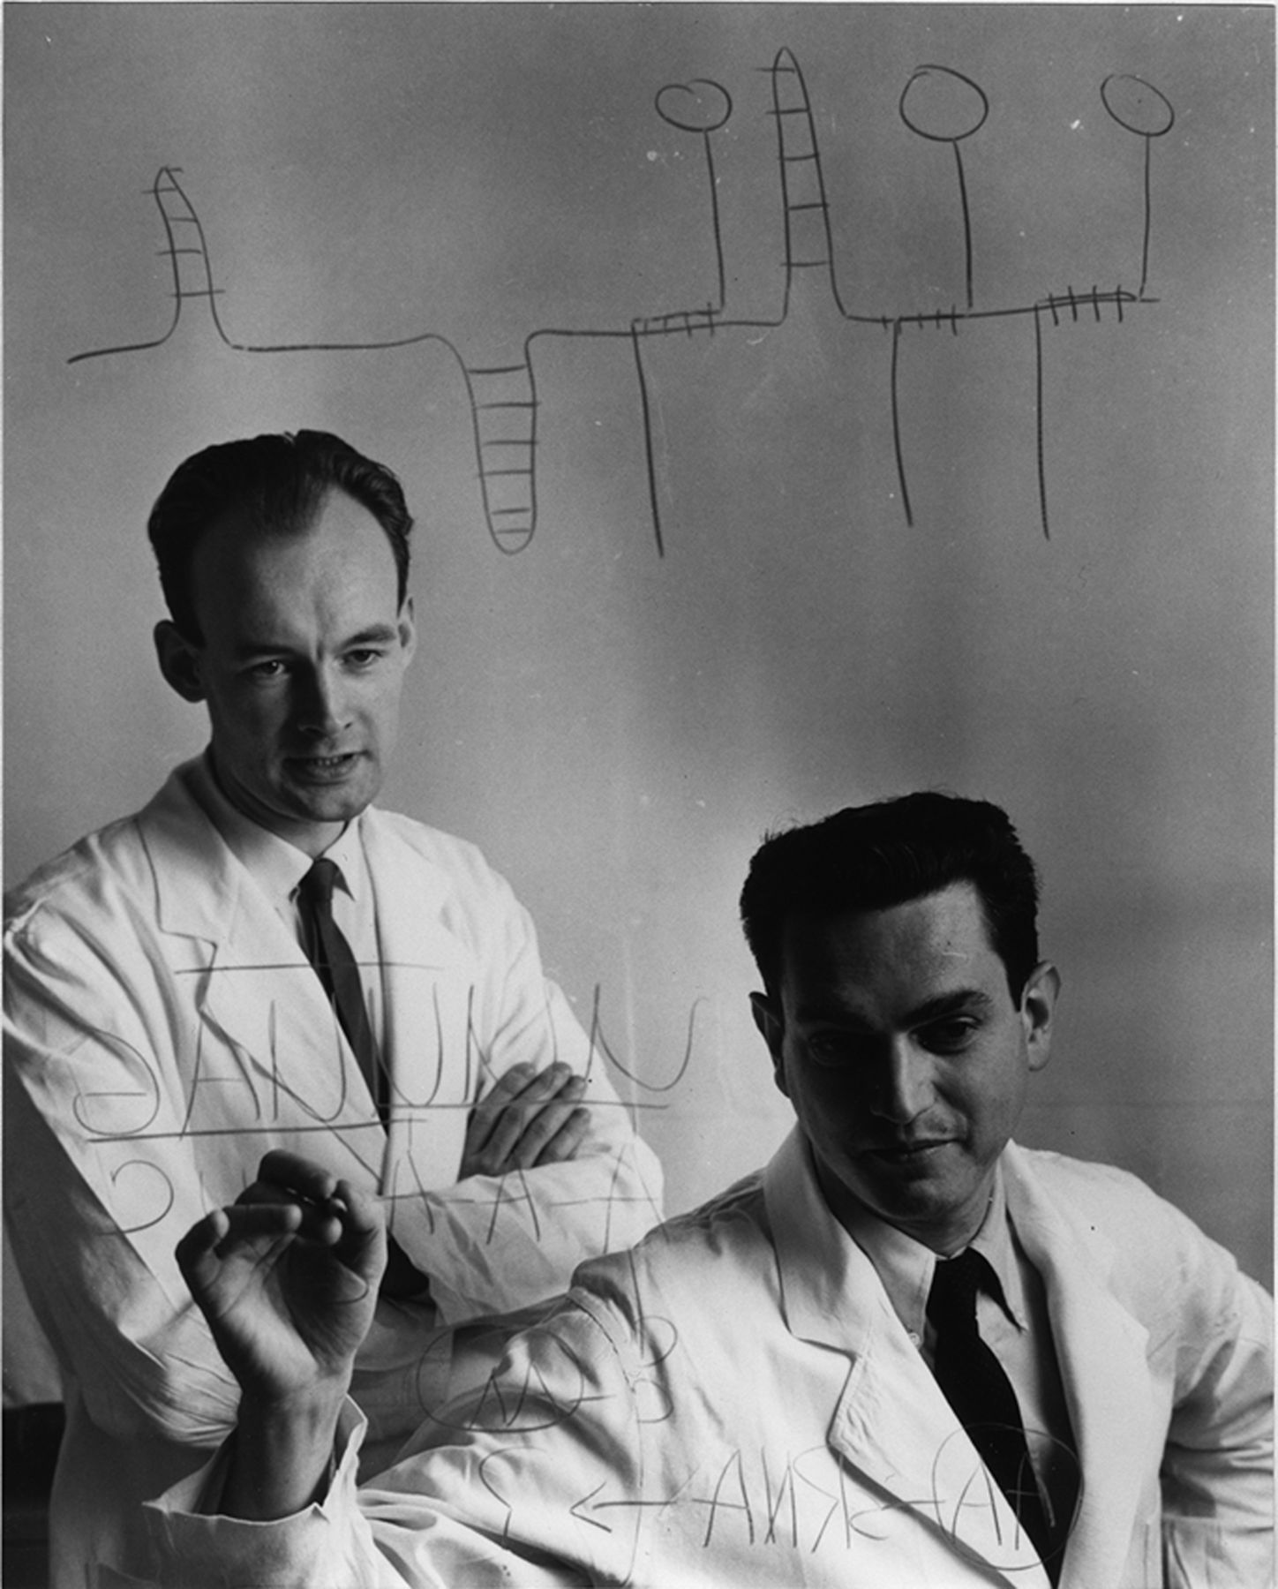
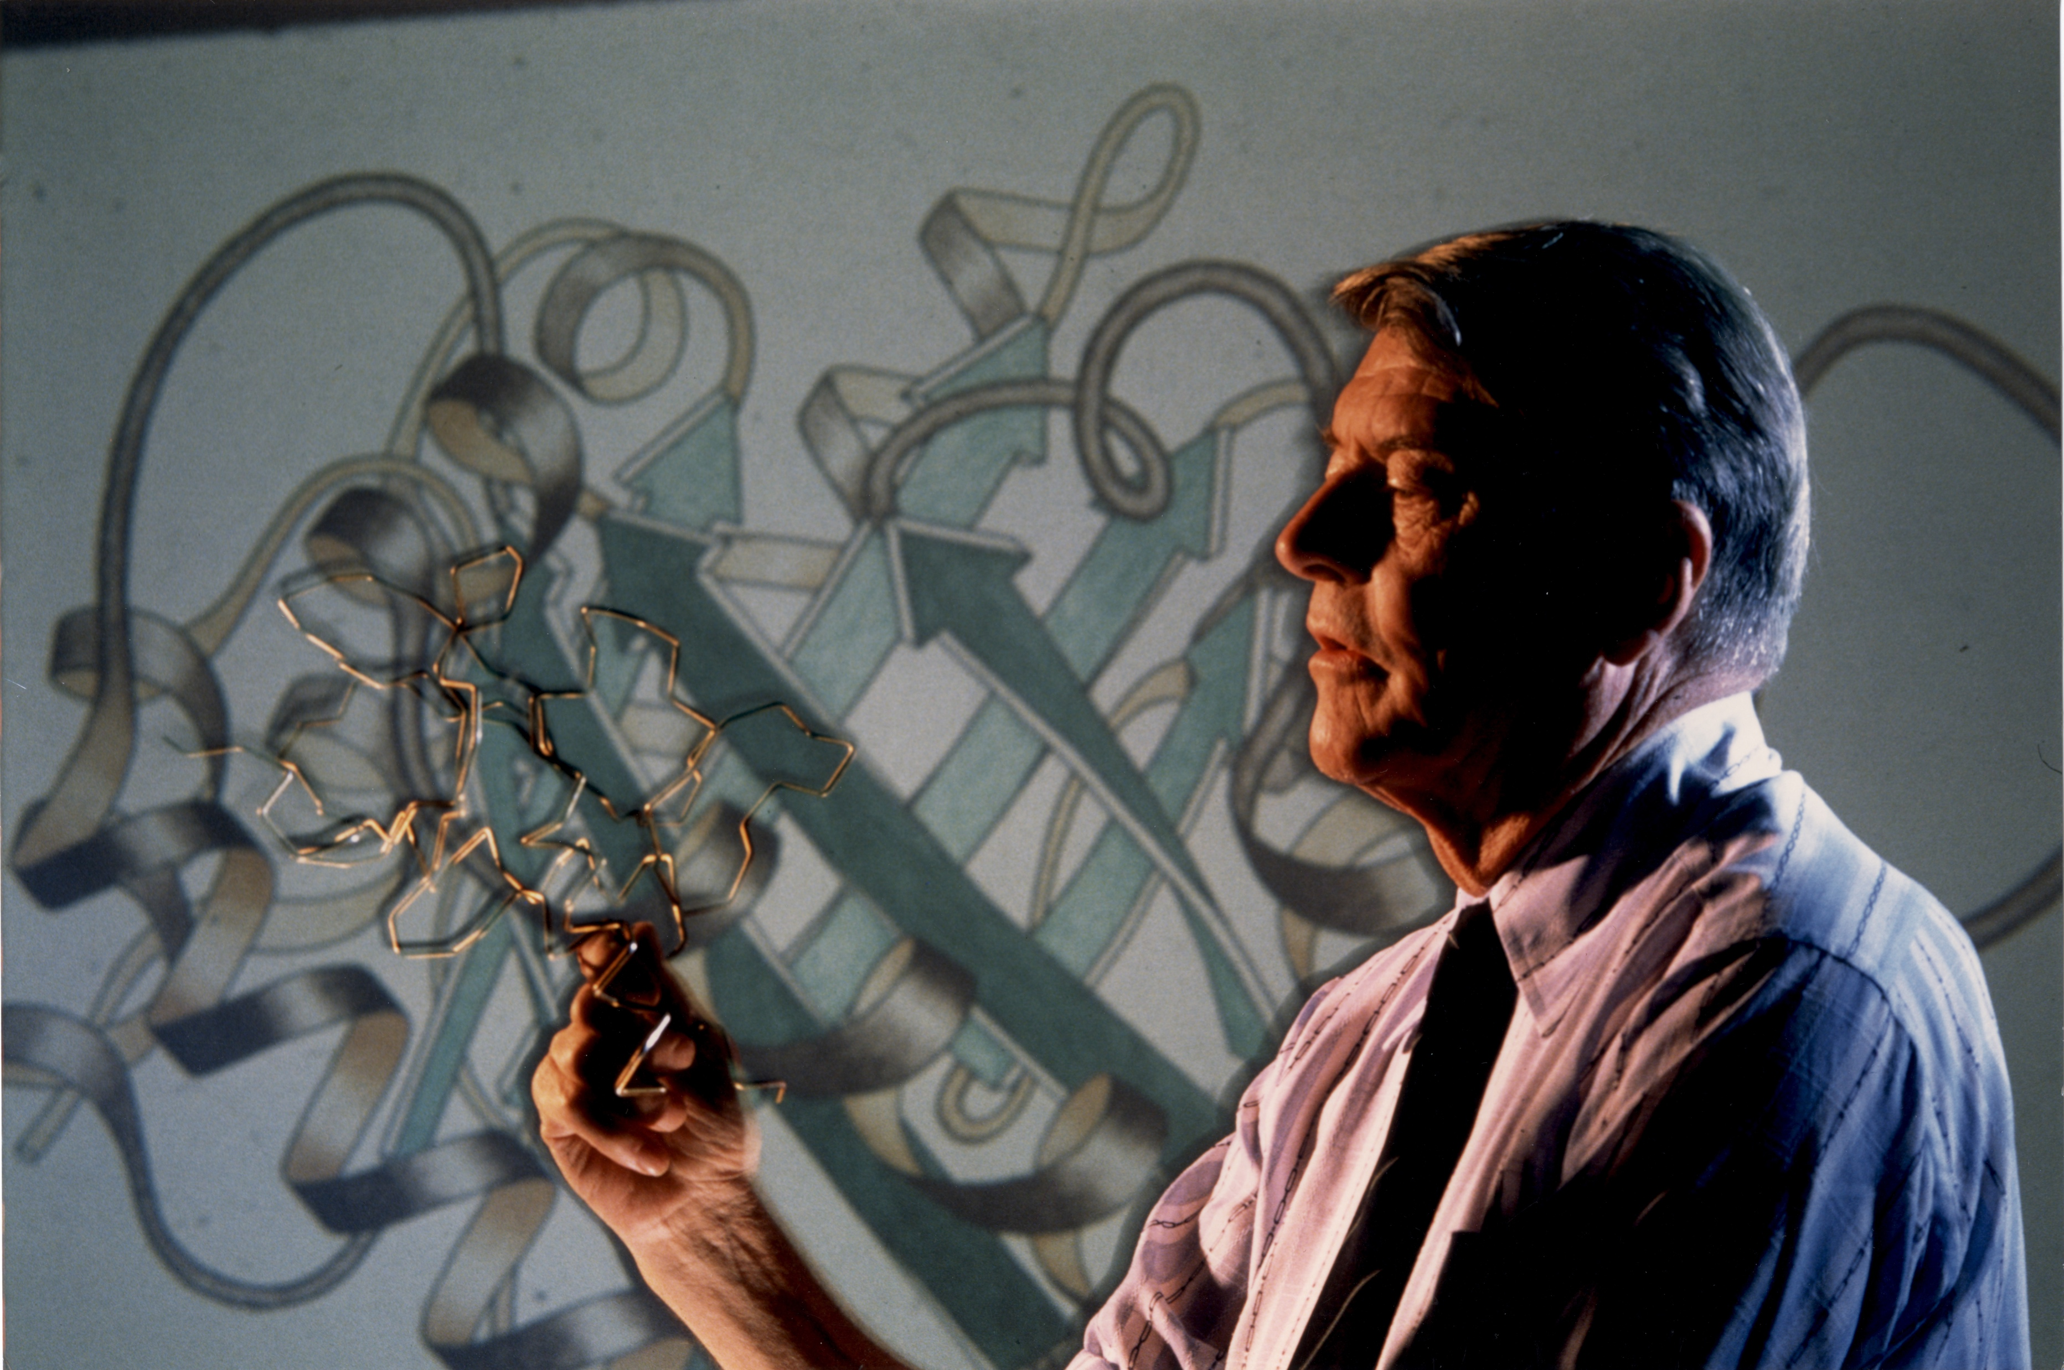
The IRP’s Nobel Prize-Winning Discoveries
20 Intramural investigators have won Nobel Prizes
Major discoveries have included:
Deciphering the genetic code
Demonstrating that protein folding can be predicted from a protein’s amino acid sequence
Discovering that ‘slow viruses’ can cause degenerative neurological diseases
Showing that responses of cells to hormones requires both receptors and G-proteins
Discovery of the hepatitis C virus
https://irp.nih.gov/about-us/honors/nobel-prize

Slide 10
Learn More

